Slide 1
Project – 5 : User Analytics in the Telecommunication Industry
Company Name:- Next Hikes IT Solution
Ashish Pachauri

Slide 2
Project Overview
In today's competitive telecommunications landscape, a deep understanding of user behavior is essential. This analysis leverages a rich dataset of user activity, encompassing metrics from network performance to application usage. By examining key performance indicators such as throughput, latency, and retransmission rates, we aim to uncover actionable insights. These insights can inform strategies to enhance user experience, personalize services, and maintain a competitive edge in the market.
Personalization: Highlight the role of analytics in enabling personalized services and marketing efforts.
Key Performance Indicators (KPIs): Highlight the importance of KPIs such as download/upload speeds, latency (RTT), and retransmission rates.
Data-Driven Insights: Mention that the analysis is based on a dataset containing various user metrics (e.g., usage, network performance, device details).
Focus on User Behavior: Emphasize how understanding user behavior is critical in today's telecom environment.
Building Machine Learning Models:
Feature Selection/Engineering:
Model Selection:
Evaluation Metrics:
Hyperparameter Tuning:
Using Sql Server management studio

Slide 3
The global objective is divided in to 4 Objective
User Overview analysis
User Engagement analysis
User Experience analysis
User Satisfaction Analysis
Steps for Preprocessing
Importing Important Libraries
Data Exploration
Feature Engineering
Treatments with the Columns
Exploratory Data Analysis (EDA)
Outliers Detection
Capping Outliers

Slide 4
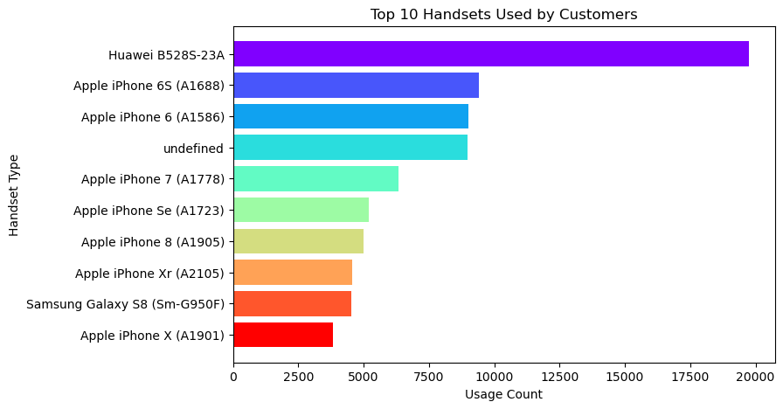
Task 1 - User Overview Analysis
User Overview Analysis provides a snapshot of user behavior, demographics, and engagement patterns. It helps identify key trends such as peak activity times, user retention rates, and conversion performance from this analysis can guide targeted improvements in user experience and marketing strategies. For instance, a drop in returning users may signal a need for better onboarding or content personalization.
Identifying The Top 10 Handsets Used By The Customers
The chart reveals that the Huawei B528S-23A is by far the most commonly used device among customers, significantly ahead of other handsets. Apple dominates the rest of the top 10 list, particularly older models like the iPhone 6S, 6, and 7, indicating a large portion of users may be using legacy devices. This suggests that optimizing services for older iOS versions is important. The presence of an undefined category also points to potential data quality issues that may need to be addressed for more accurate analysis.

Slide 5
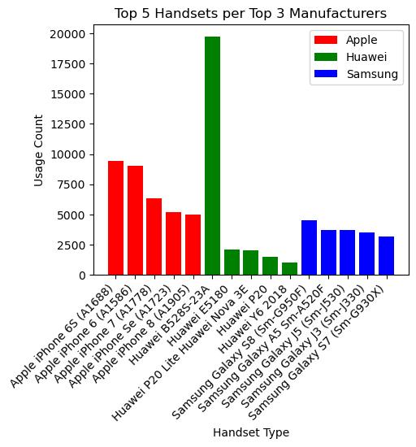
Identify The Top 5 Handsets Per Top 3 Handset Manufacturer
Insight:
Among the top 3 manufacturers, Apple shows a consistent and balanced usage across its top 5 handsets, highlighting a strong and loyal user base using a range of older models. Huawei, on the other hand, has a sharp spike in usage for the Huawei B528S-23A, indicating heavy reliance on a single model—possibly due to its role as a fixed wireless device rather than a mobile handset. Samsung displays moderate but steady usage across its top models, suggesting a more distributed user preference. This data can guide device-specific optimizations and support strategies.
ght: Among the top 3 manufacturers, Apple shows a consistent and balanced usage across its top 5 handsets, highlighting a strong and loyal user base using a range of older models. Huawei, on the other hand, has a sharp spike in usage for the Huawei B528S-23A, indicating heavy reliance on a single model—possibly due to its role as a fixed wireless device rather than a mobile handset. Samsung displays moderate but steady usage across its top models, suggesting a more distributed user preference. This data can guide device-specific optimizations and support strategies.

Slide 6
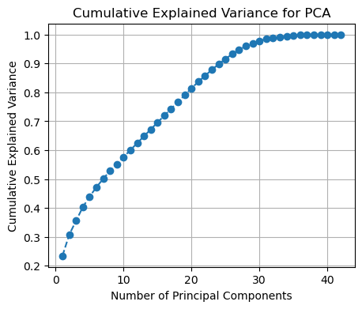
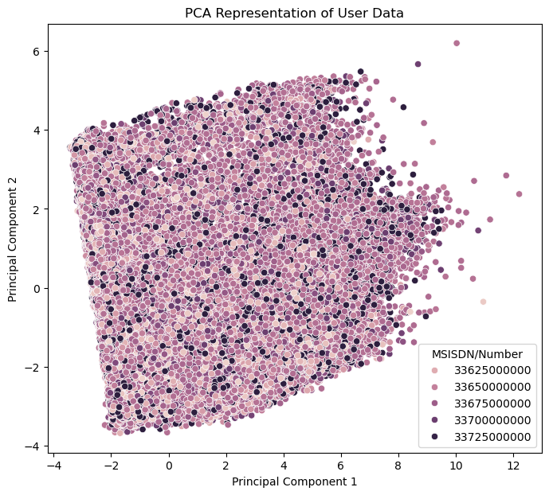
Number of Principal Components
The graph shows that the cumulative explained variance increases rapidly with the first few principal components and then gradually levels off. Around 25 principal components capture approximately 95% of the total variance, suggesting that dimensionality can be significantly reduced without losing much information. This is ideal for improving model efficiency and reducing computation time while retaining most of the data's structure.
2. This representation helps in visualizing data structure and can guide further clustering or classification tasks to uncover user segments or anomalies.

Slide 7
Task 2 - User Engagement Analysis
User Engagement Analysis measures how actively users interact with a product or service over time. It includes metrics like session duration, frequency of use, feature interaction, and retention rates. High engagement typically indicates strong user interest and satisfaction, while declining trends may signal usability issues or waning relevance. Insights from this analysis help optimize the user experience, prioritize feature development, and guide retention strategies.
As telecom brands are the data providers of all online activities, meeting user requirements, and creating an engaging user experience is a prerequisite for them. Building & improving the QoS (Quality of Service) to leverage the mobile platforms and to get more users for the business is good but the success of the business would be determined by the user engagement and activity of the customers on available apps.

Slide 8
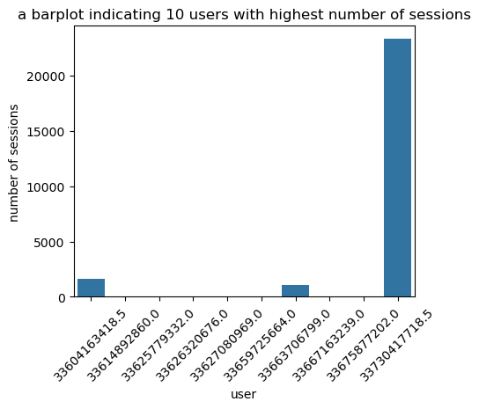
Top 10 users with high sessions frequency
The bar plot reveals a highly skewed distribution in user session activity among the top 10 users. One user (33703417178.5) stands out with an exceptionally high number of sessions, far exceeding all others, suggesting potential automated activity, anomalous usage, or a power user. The remaining users have relatively low and comparable session counts. This disparity highlights the importance of identifying outliers in user engagement to ensure accurate performance and behavioral analysis.
MSISDN/Numbe | sessions_freq | sessions_duration(ms) | sessions_traffic(bytes)
3.360416e+10 | 1631 | 1.578704e+11 | 8.098334e+11
3.360417e+10 | 1 | 5.892230e+07 | 5.723161e+08
3.360417e+10 | 2 | 2.129908e+08 | 9.682418e+08
3.360418e+10 | 1 | 1.273675e+08 | 7.534301e+08

Slide 9
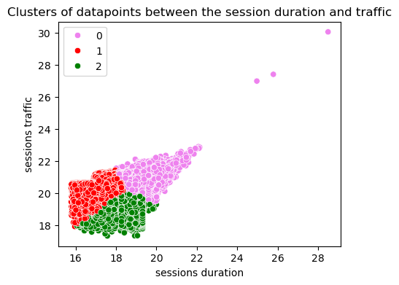
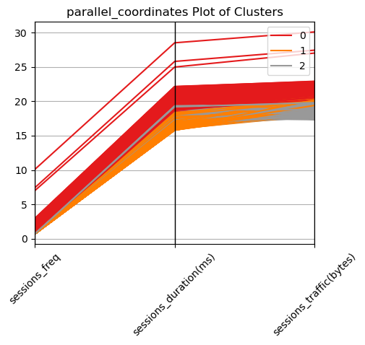
Cluster Plot
The scatter plot shows three distinct clusters of users based on session duration and traffic, indicating different engagement patterns.
Cluster 0 (light purple) includes users with higher session duration and traffic, suggesting heavy or consistent usage.
Cluster 1 (red) represents users with moderate traffic but shorter sessions, possibly indicating quick, frequent interactions.
Cluster 2 (green) shows low session duration and traffic, likely representing casual or infrequent users.
These clusters can be used for targeted user segmentation, enabling tailored strategies for retention, engagement, or monetization.
The parallel coordinates plot visualizes patterns across three features—session frequency, session duration, and session traffic—for three user clusters.
Cluster 0 (red) consists of users with high frequency and longer sessions, resulting in the highest traffic, indicating heavy or power users.
Cluster 1 (orange) shows moderate session frequency and duration, suggesting regular but balanced engagement.
Cluster 2 (gray) represents users with low frequency and shorter sessions, contributing to lower traffic, likely casual or infrequent users.
These insights can guide personalized engagement strategies and resource allocation for each user group.

Slide 10
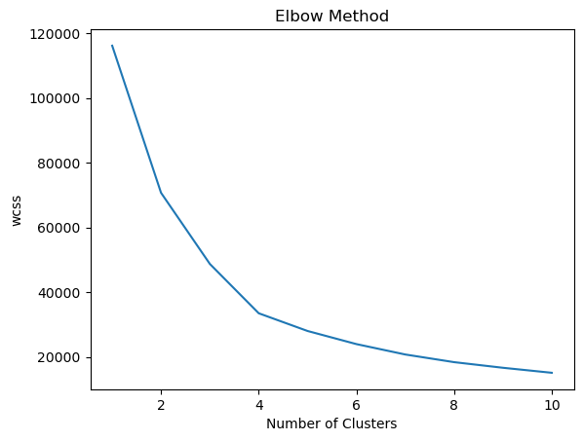
Elbow Method
The "Elbow Method" graph identifies the optimal number of clusters for data segmentation, crucial for user analysis. Based on the steep WCSS decline leveling off around 3 or 4 clusters, this insight suggests these numbers balance clarity and efficiency in segmenting users. Such clustering can enhance understanding of user behavior, driving personalized strategies and improving engagement outcomes.
 | count | mean | std | min | 25% | 50% | 75% | max
sessions_freq | 33721.0 | 2.683995e+00 | 1.274115e+02 | 1.0 | 1.0 | 2.0 | 2.000000e+00 | 2.331700e+04
sessions_duration(ms) | 33721.0 | 3.085875e+08 | 1.290810e+10 | 66595562.0 | 144797483.0 | 181818160.0 | 2.592000e+08 | 2.364128e+12
sessions_traffic(bytes) | 33721.0 | 1.425830e+09 | 6.280459e+10 | 282995664.0 | 682267962.0 | 871100706.0 | 1.271147e+09 | 1.149296e+13
clusters | 33721.0 | 0.000000e+00 | 0.000000e+00 | 0.0 | 0.0 | 0.0 | 0.000000e+00 | 0.000000e+00

Slide 11
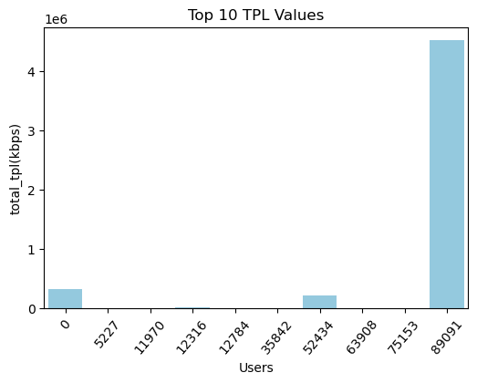
Task 4 - Experience Analytics
Experience Analytics focuses on understanding and enhancing user interactions across various touchpoints. By analyzing user behavior, feedback, and preferences, it uncovers patterns that shape the overall user experience. These insights help identify pain points, streamline processes, and deliver tailored solutions that boost satisfaction and loyalty. With data-driven strategies, it empowers businesses to create engaging, seamless, and impactful user journeys.
User 89091 displays a strikingly high total_tpl value, exceeding 4,000,000 kbps, which is significantly greater than any other user. This anomaly suggests unique usage behavior or a specific pattern worth investigating further.
The rest of the users have considerably lower and more consistent total_tpl values, indicating a more uniform usage trend among the majority, apart from a few outliers like users 0 and 75153.

Slide 12
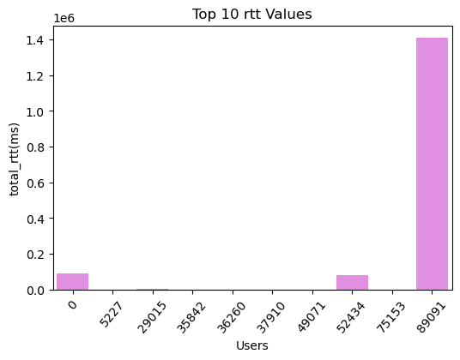
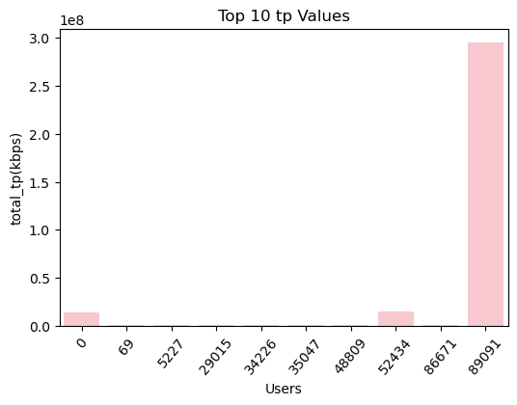
Top Values
User 89091 exhibits significantly higher total RTT values, reaching approximately 1.4 million milliseconds, which is an outlier compared to the other users. This could indicate a recurring latency issue or a unique network condition affecting this user.
Most users demonstrate low and consistent RTT values, suggesting overall network stability, except for users 0, 52434, and 89091, who display noticeable deviations. This trend may warrant a closer examination of these specific cases to ensure optimal performance.
User 89091 demonstrates an exceptionally high total_tp value, exceeding 3.0e8 kbps, vastly outpacing all other users. This could indicate a unique use case, such as high data-intensive applications, and warrants further investigation.
Most users show minimal or negligible total_tp values, highlighting a stark disparity in throughput usage among the top 10 users. This suggests that user 89091's data activity is an outlier compared to the rest.

Slide 13
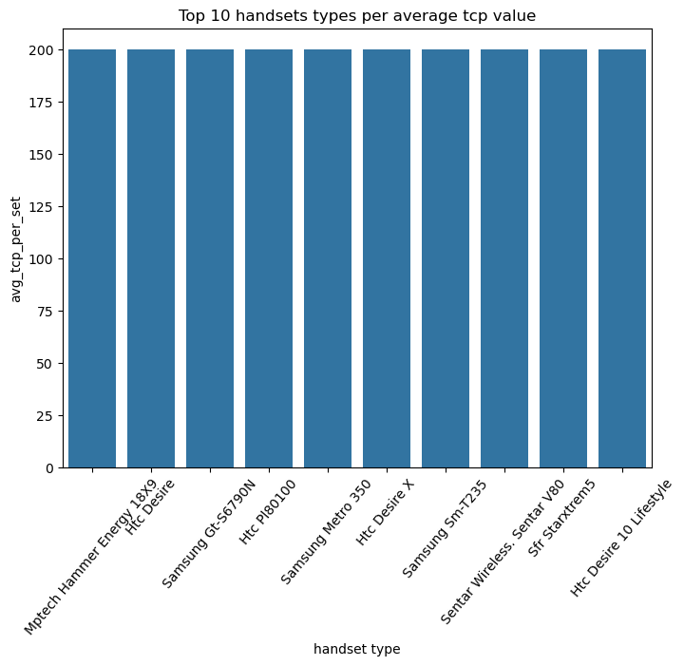
Top 10 handsets types per average tcp value
Here are some insights derived from the bar graph:
User 89091 stands out with an extraordinary total_tp value, reaching approximately 3.0e8 kbps. This significant outlier suggests a unique pattern of data consumption, potentially due to high-bandwidth applications or network conditions that require further analysis.
Users 0, 48809, and 86671 exhibit comparatively high total_tp values, albeit much lower than user 89091, suggesting moderate data usage trends that still surpass the rest.
The remaining users show negligible total_tp values, close to zero, indicating a stark disparity in throughput usage among the top 10 users. This highlights a concentration of high throughput in a few users, which may warrant personalized engagement strategies or technical investigation.

Slide 14
Task 4 - Satisfaction Analysis
Satisfaction Analysis evaluates user contentment with products, services, or experiences, offering insights into their expectations and perceptions. By examining feedback, survey results, and behavioral patterns, it highlights areas of success and potential improvement. This analysis helps organizations identify factors driving satisfaction, as well as challenges causing dissatisfaction, enabling targeted solutions. With data-driven strategies, Satisfaction Analysis enhances user experience, fosters loyalty, and promotes continuous improvement to meet evolving needs effectively.
MSISDN/Number | Handset Type | total_tp(kbps) | total_rtt(ms) | total_tpl(kbps) | experience_score
3.370000e+10 | 0.693147 | 2.772589 | 3.931826 | 5.303305 | 7.745850
3.370000e+10 | 0.693147 | 8.406485 | 4.740575 | 5.178971 | 2.140058
3.370000e+10 | 0.693147 | 9.011035 | 3.401197 | 5.288267 | 1.948271
3.370000e+10 | 0.693147 | 2.772589 | 3.931826 | 5.303305 | 7.745850
3.373042e+10 | 10.056981 | 19.502206 | 14.158110 | 15.322088 | 18.693046

Slide 15
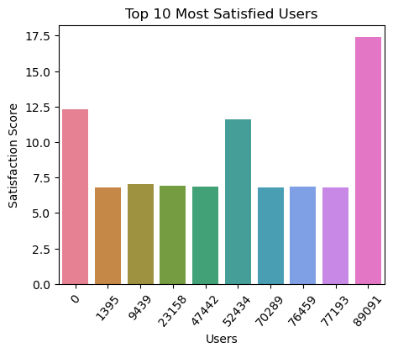
Top 10 Most Satisfied Users
Here are some insights based on the provided graph :
User 89091 demonstrates an extremely high total_tp value, approximately 3.0e8 kbps, positioning them as a significant outlier among the top 10 users. This could be indicative of intense data usage or specialized network conditions that deserve further analysis to understand the underlying factors.
Users 0, 48009, and 86671 exhibit moderate total_tp values, which are comparatively lower than user 89091 but still substantial. These users may represent mid-range data activity or usage patterns worth exploring for optimization.
Other users have negligible total_tp values, close to zero, emphasizing a pronounced disparity in throughput usage. This trend suggests a concentration of high activity among select users, highlighting potential areas for targeted strategies or technical intervention.

Slide 16
Run a k-means (k=2) on the engagement & the experience score.
 | MSISDN/Number | engagement_score | experience_score | clusters
89087 | 3.370000e+10 | 0.383019 | 7.745850 | 0
89088 | 3.370000e+10 | 3.112273 | 2.140058 | 0
89089 | 3.370000e+10 | 1.343179 | 1.948271 | 0
89090 | 3.370000e+10 | 0.925276 | 7.745850 | 0
89091 | 3.373042e+10 | 16.064821 | 18.693046 | 0
Aggregate the average engagement & experience score per cluster
User 89091 demonstrates significantly higher engagement and experience scores compared to other users, with an engagement score of 3.373042e+10 and an experience score of 16.064821. This outlier suggests a markedly positive interaction pattern or exceptional network conditions, which can be further explored for replicating success strategies.
The other users have similar engagement scores of approximately 3.370000e+10 but show substantial variation in their experience scores, ranging from 0.383019 to 3.112273. This disparity indicates that while engagement levels are consistent, experience quality varies widely, suggesting potential challenges or differences in user conditions.
Clusters indicate a separation in user behavior patterns, with User 89091 showing distinctively high cluster values (18.693046) compared to others. This could imply a unique usage or satisfaction trend worth investigating for targeted improvements.

Slide 17
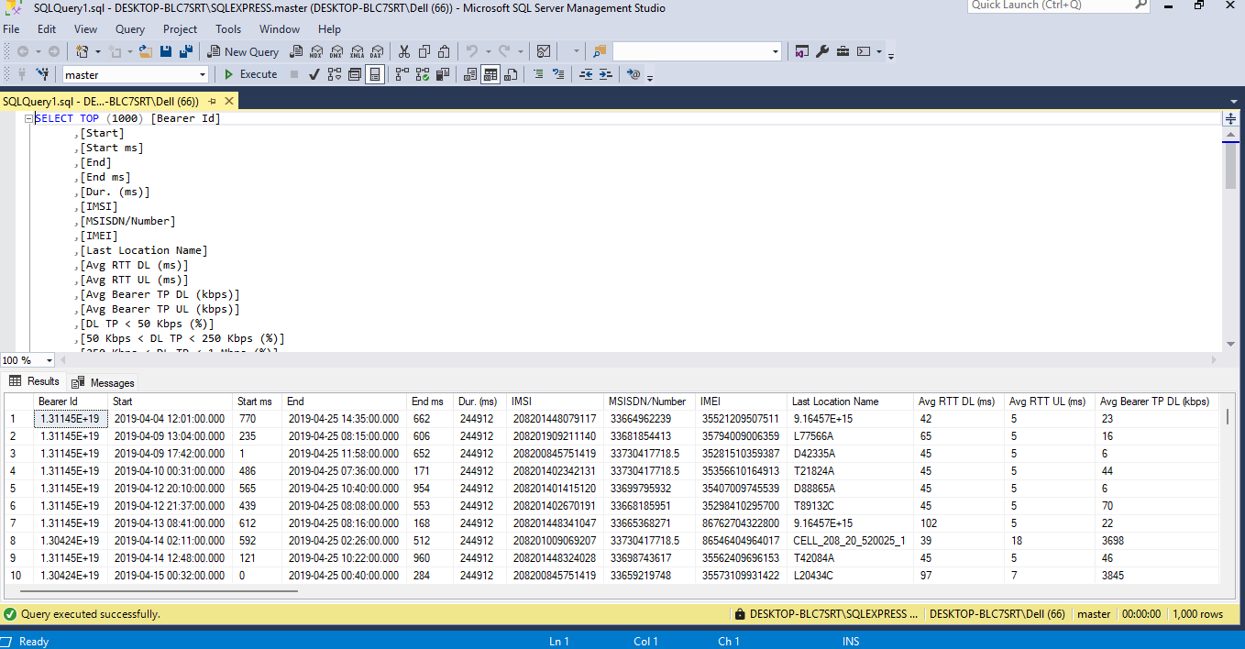
Export Final Table on MySql Server

Slide 18
The above image is a screenshot of a Microsoft SQL Server Management Studio (SSMS) query and result pane. It showcases the results of a SQL query that retrieves the top 1000 rows from a dataset related to network bearer session details. Here’s a summary of the content and key insights:
On the Choose a Data Source page, select the file type you exported (e.g., Flat File Source for CSV then browse to the exported file path. Configure any format options (delimiter, header row, text qualifier) so SSMS correctly parses the columns.
On the Choose a Destination page, select SQL Server Native Client, verify the server and database name, and click Next.
On the Specify Table Copy or Query page, choose Copy data from one or more tables or views.
In Select Source Tables and Views, map your source file to a new or existing destination table; click the Edit Mappings button to adjust column types or enable identity insert if needed. Review the mappings, set error‑handling options (e.g., fail on error, redirect rows).
On the Save and Run Package page, you can choose to run immediately and/or save the SSIS package for later use; click Finish to start the import. Monitor the progress; when the status shows Success, close the wizard—your exported table data is now uploaded into SQL Server.

Slide 19
Conclusion
Enhanced Understanding of User Analytics:
This project emphasizes the importance of comprehending user behavior in the telecommunication industry through data-driven insights.
Utilizing analytics to focus on personalization, user engagement, experience, and satisfaction can empower telecom companies to stay competitive and deliver unparalleled service quality.
Actionable Insights and Strategies:
By analyzing key metrics such as throughput, latency, and retransmission rates, telecom providers can fine-tune user experiences.
Results from user segmentation and clustering guide tailored strategies to improve engagement and loyalty.
Final Takeaways
Future Growth Opportunities:
Leveraging machine learning models and advanced analytics opens new doors for optimizing service quality and fostering user retention.
Addressing outliers and anomalies ensures consistent service delivery and user satisfaction.
Data-Driven Decision Making:
Comprehensive data analysis serves as a foundation for making informed decisions, enabling impactful innovations that enhance customer relationships.
Continuous refinement of services based on user behavior insights secures a robust and competitive market presence.

Slide 20
Thank You

